Slide 1

JEDI 2.0-Development-GROUP-C-FLIPKART-PROJECT-2024
FlipFit

Slide 2
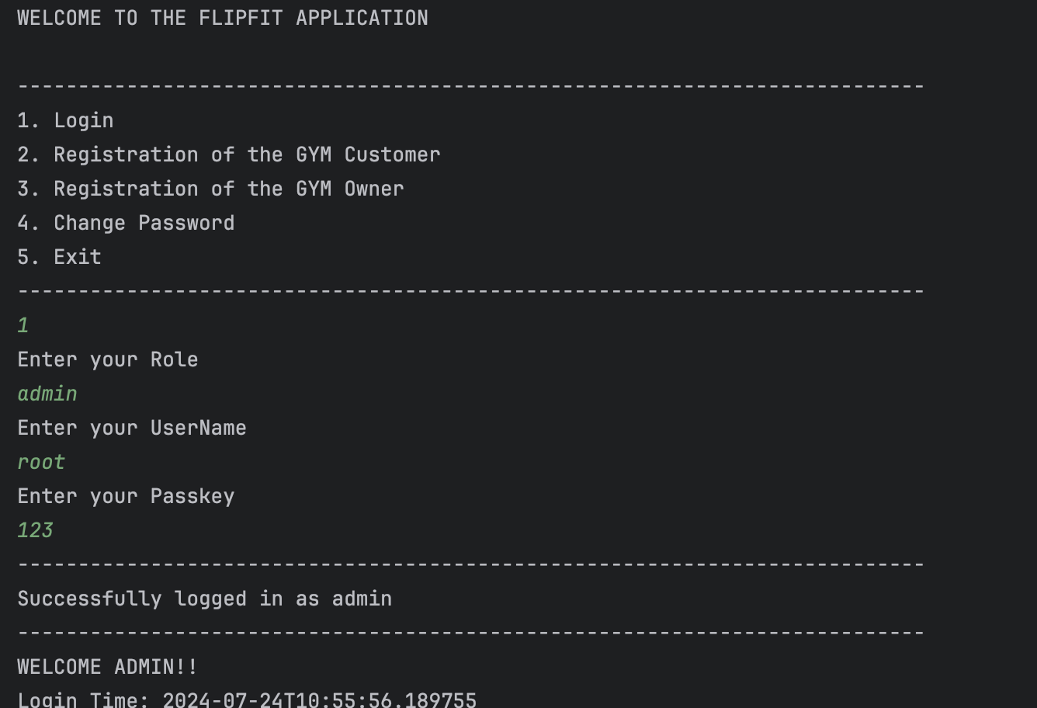
THE ONLINE GYM BOOKING PORTAL
EMPOWERING FITNESS ENTHUSIASTS!!

Slide 3
STAKEHOLDERS
Amit Kumar Balyan
Flipkart
Raksha
SPONSORS
SME’s
Cordinators

Slide 4
Our Team
Swetha
Jasleen (Team leader)
Aryan
Divanshu
Dheeraj
Hariom
Deeksha

Slide 5
TABLE OF CONTENTS
Introduction Problem Statement
User Stories Proposed Solution
Class UML Diagrams
Work Progress
Tech Stack
Challenges Faced
Future Enhancements
MAIN TOPICS

Slide 6
PROBLEM STATEMENT
Design a backend system for a new enterprise application that Flipkart is launching, FlipFit. Flipkart is partnering up with gyms across Bangalore to
enter into the fitness space. For the Beta launch the requirements are as follows:
Functional Requirements
Multiple centers throughout Bangalore.
Gym owner inputs: Fixed time slots and seat availability.
Slot details.
User operations: Register, Login, View slots, View bookings, Book slots, etc.

Slide 7


User Stories
Customer
View all gym centres
View my bookings Book a slot
Cancel booking
Make payments
GymOwner
View gym Centres
Add new gym Centres
Add slots in gym Centres Request admin approval for centres
Request Gym Owner approval
Admin
View gym owner(s)
Approve gym centre(s) requests
Approve gym owner(s)

Slide 8
PROPOSED SOLUTION ARCHITECTURE

Slide 9
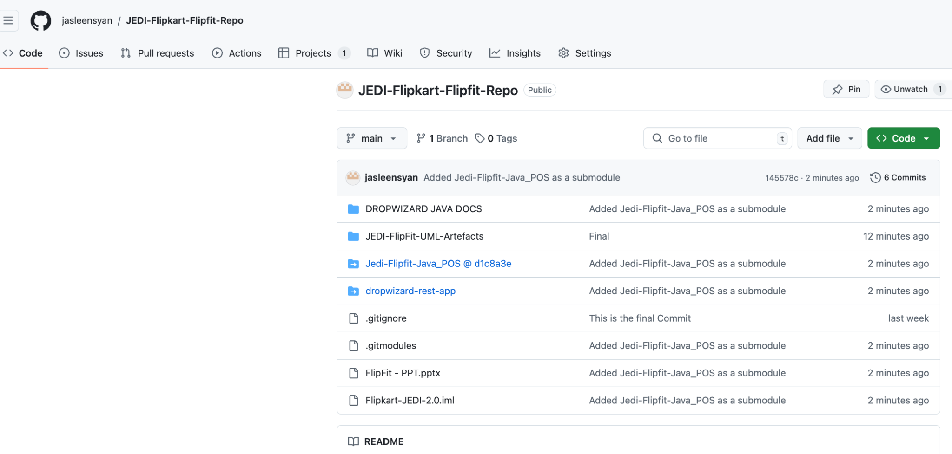
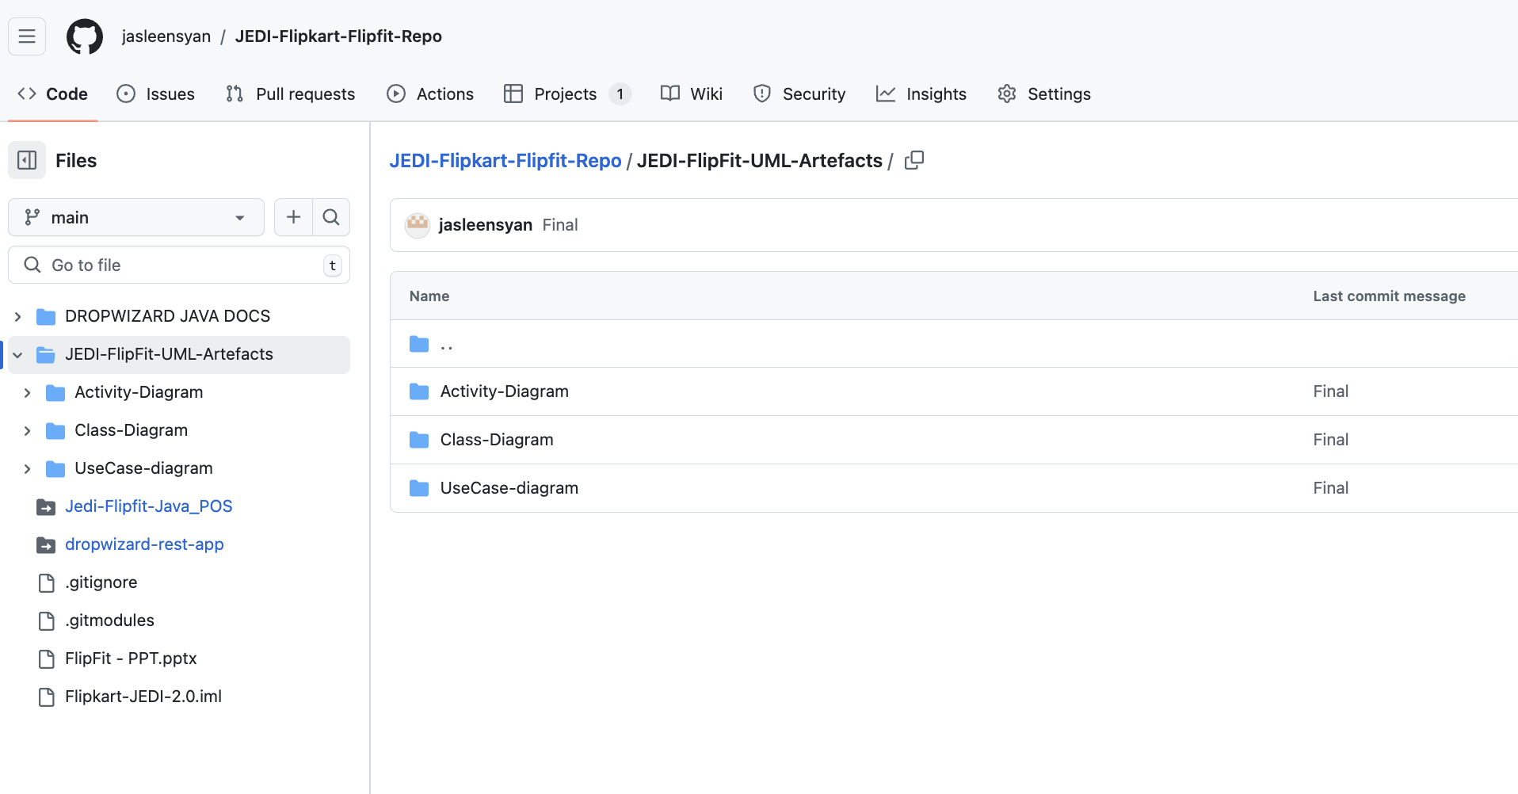
Git Structure

Slide 10
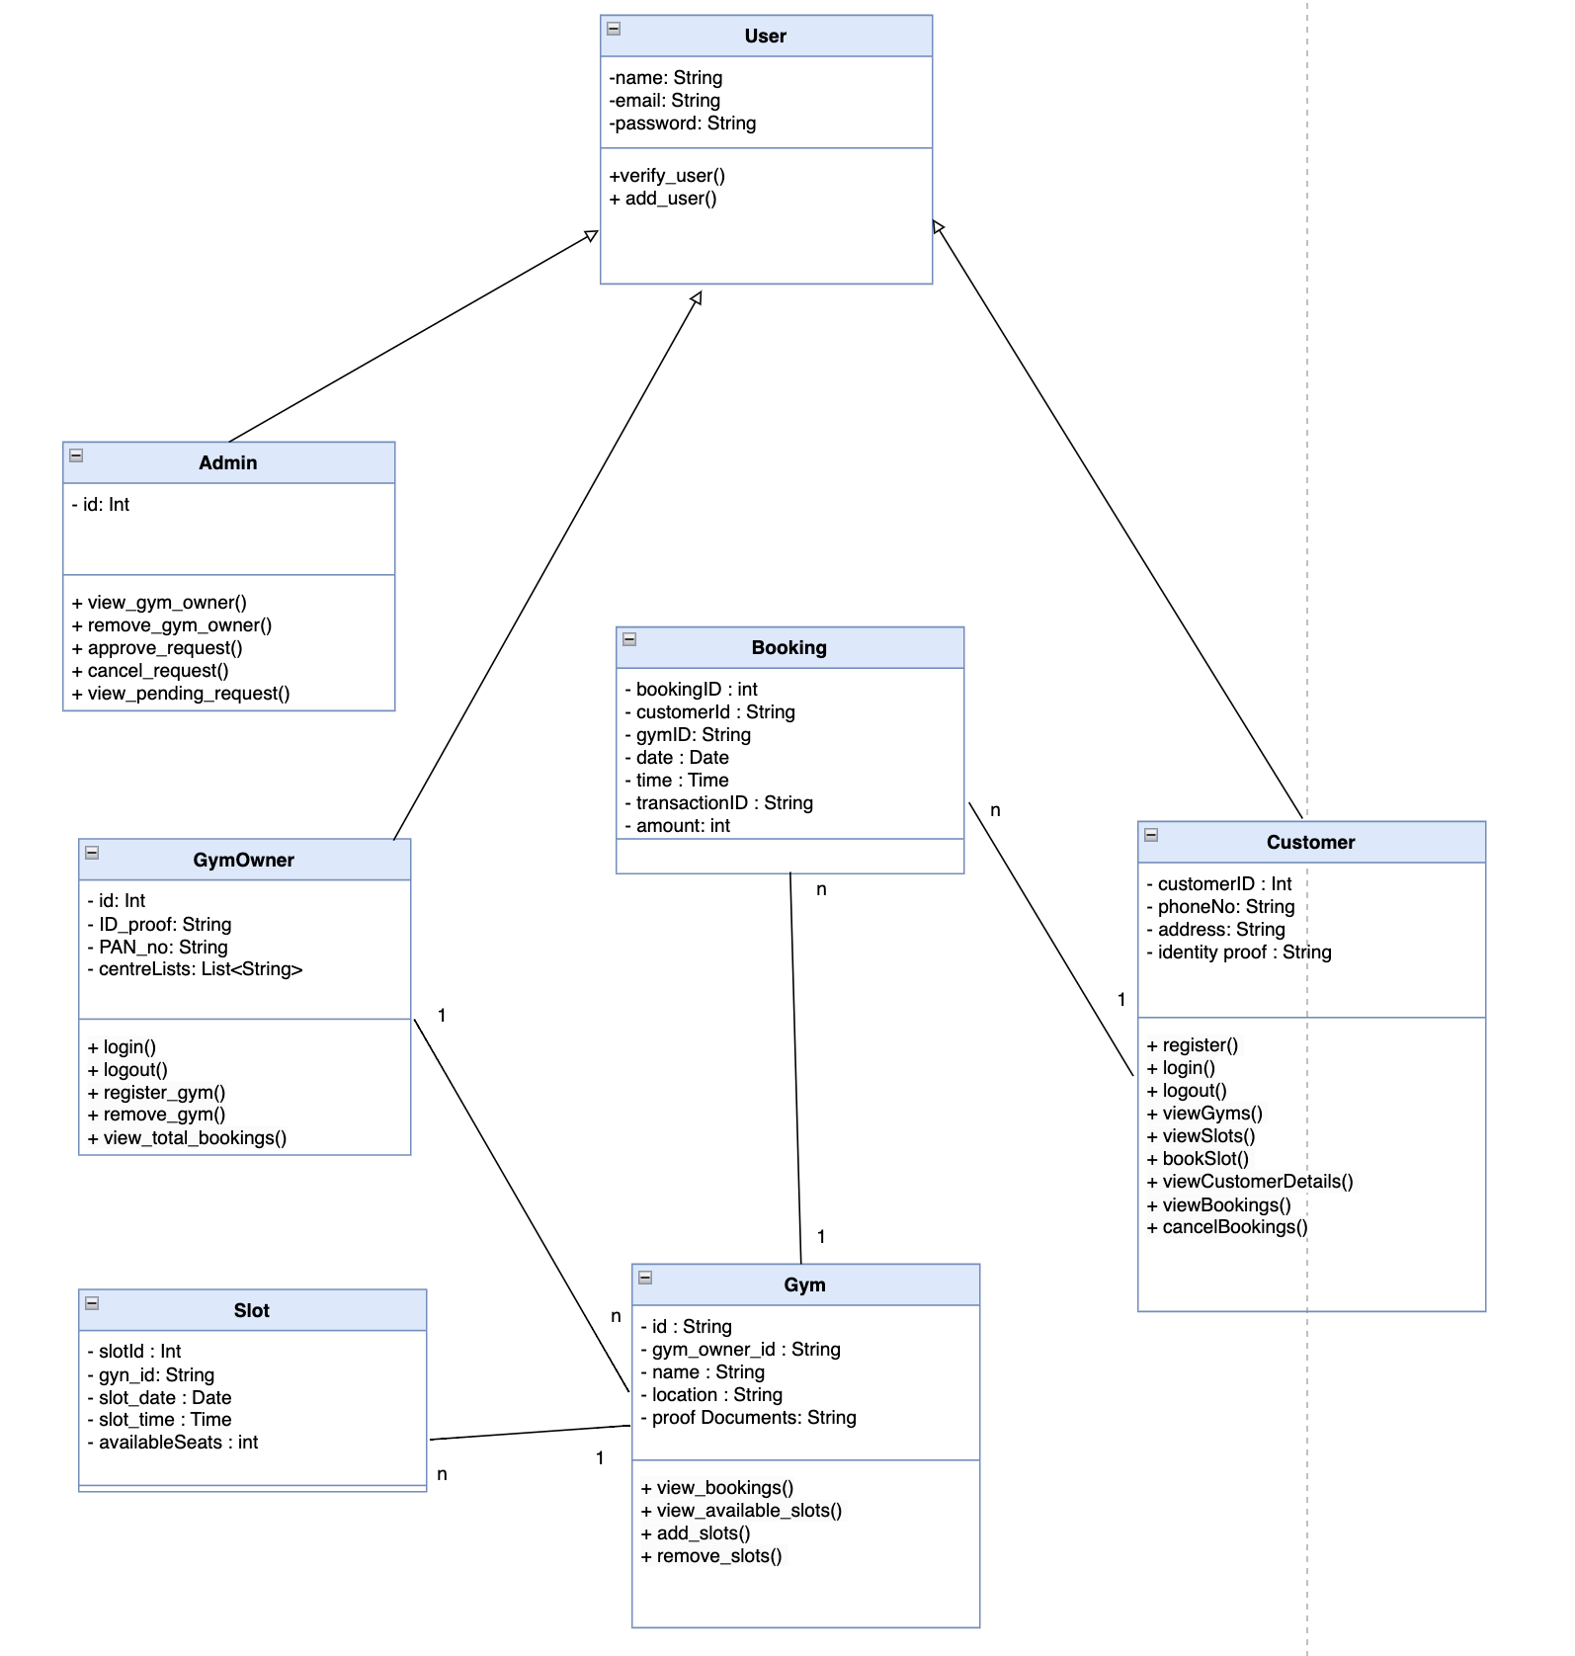
CLASS
DIAGRAM

Slide 11
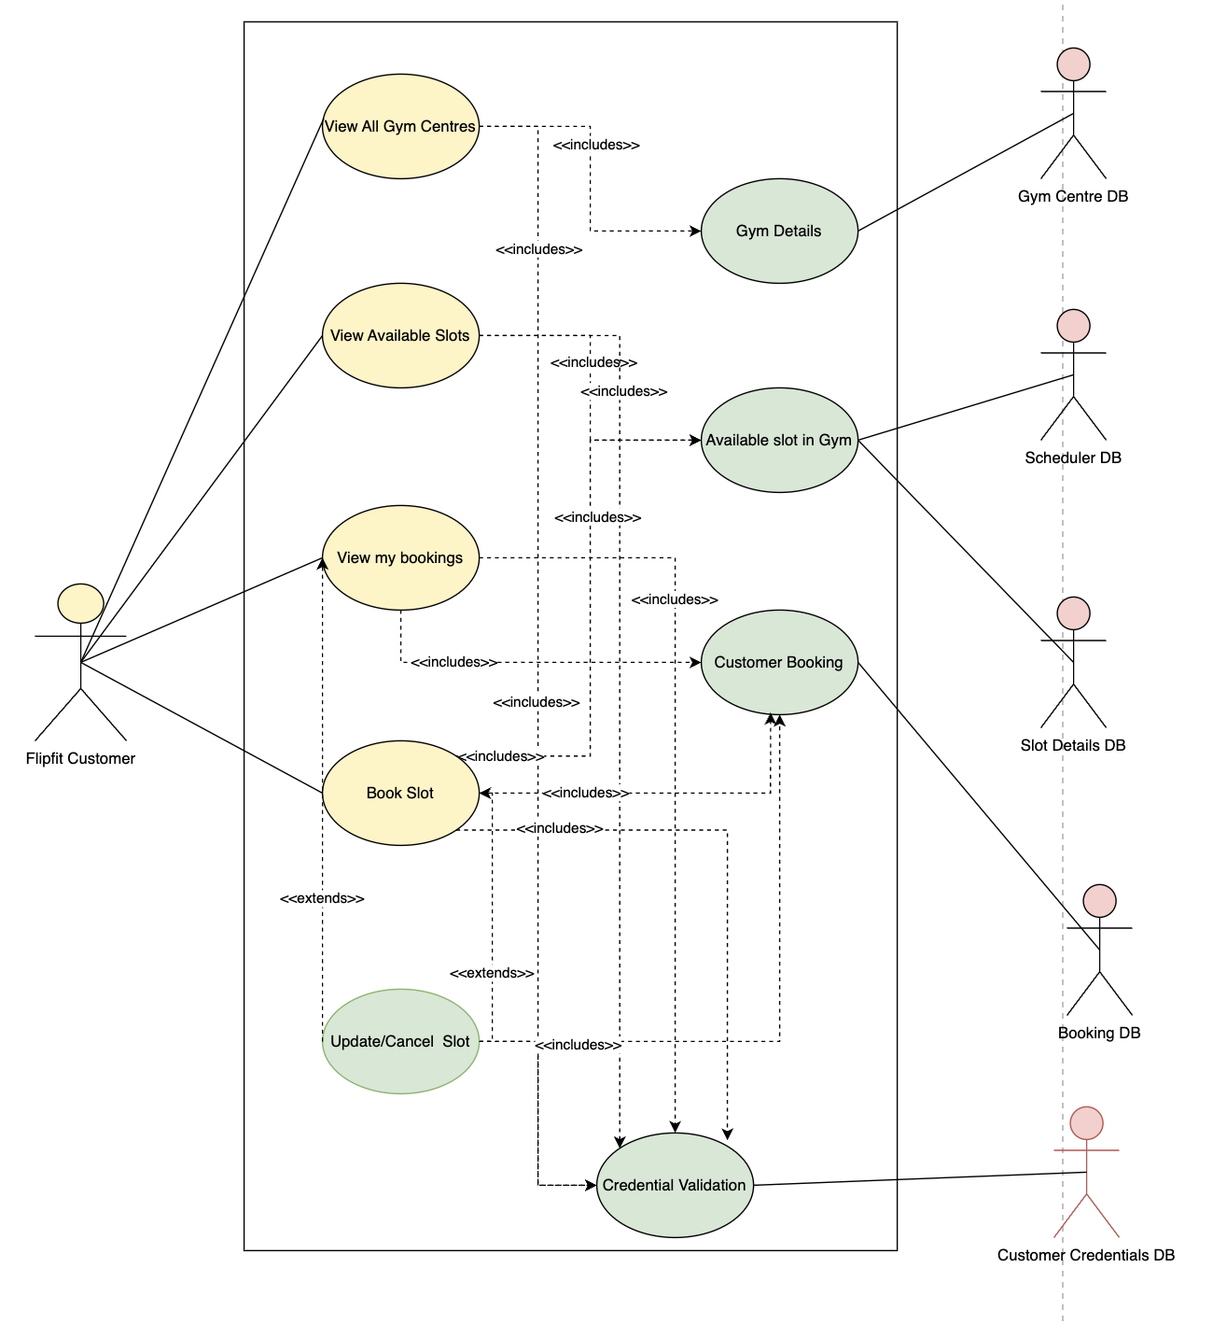
USE CASE DIAGRAM
For Customer

Slide 12
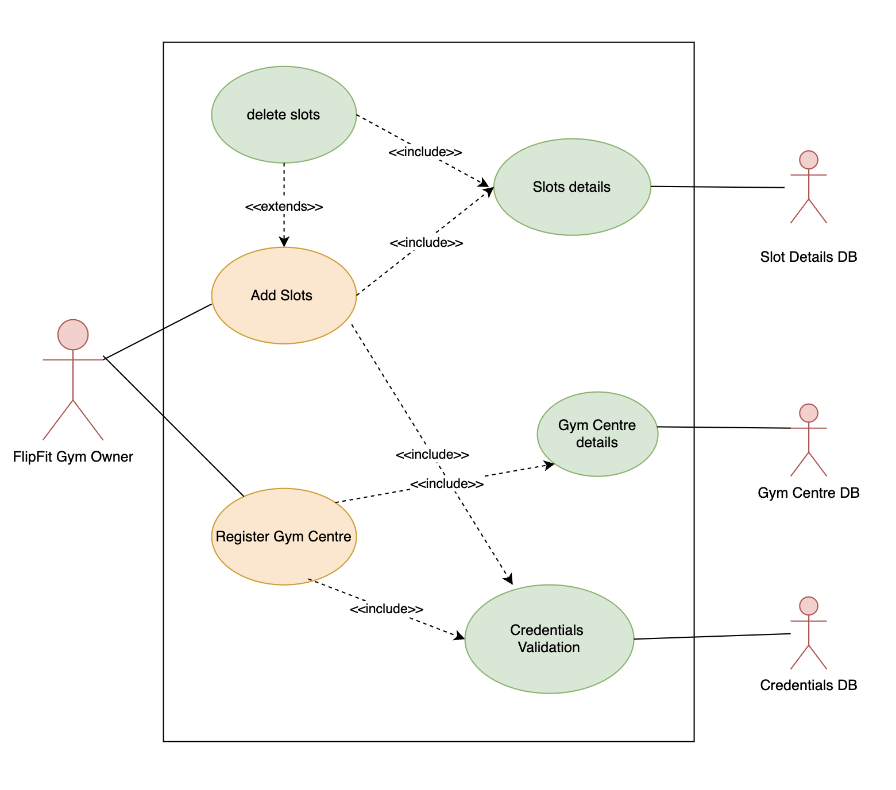
USE CASE DIAGRAM
For Gym Owner

Slide 13
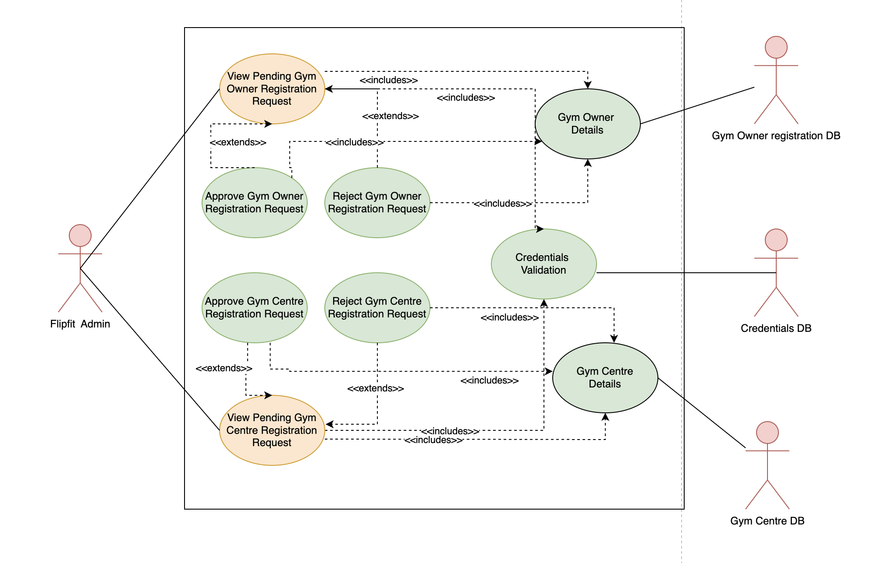
USE CASE DIAGRAM
For Admin

Slide 14
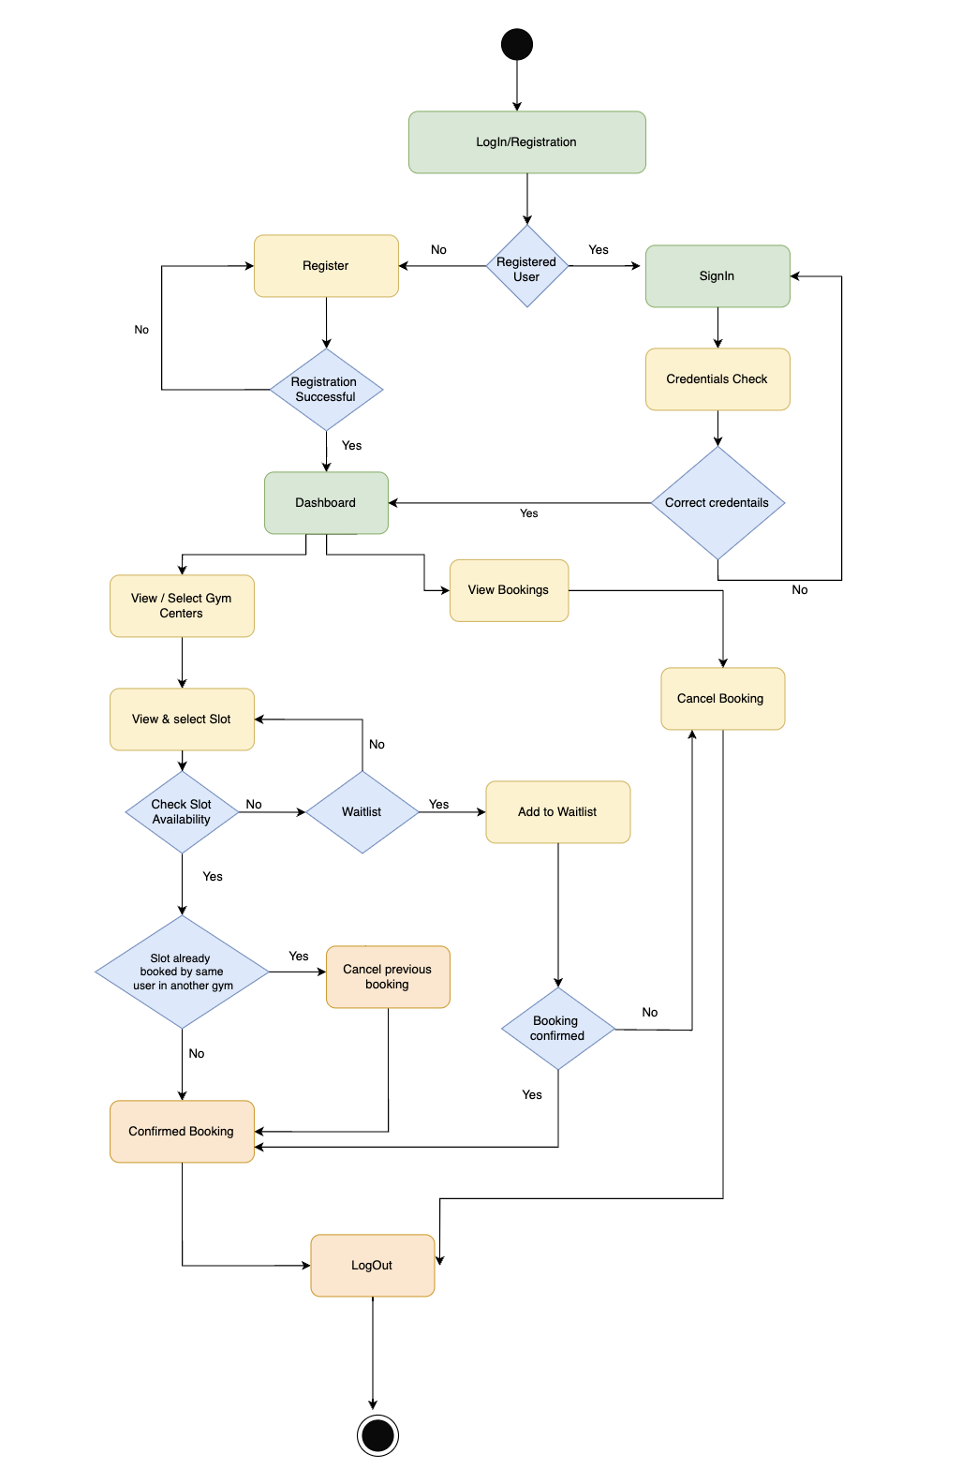
ACTIVITY DIAGRAM
For Customer

Slide 15
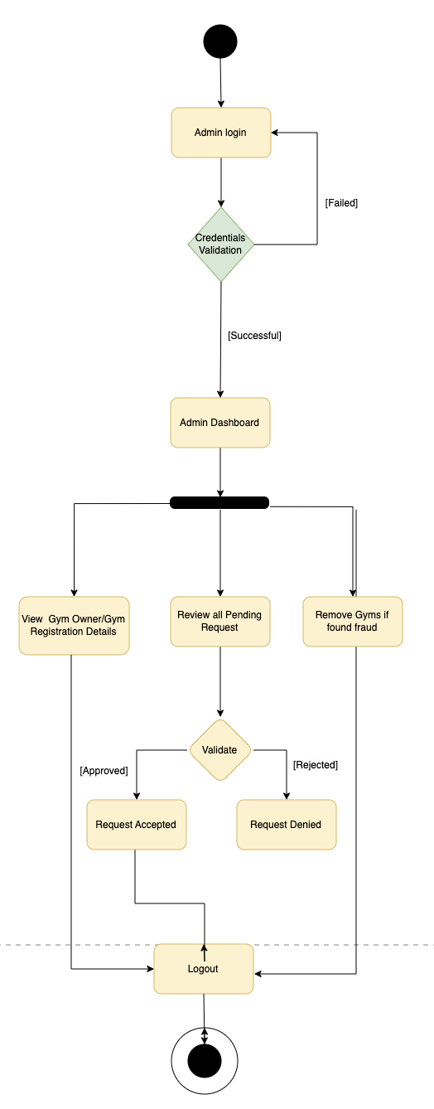
ACTIVITY DIAGRAM
For Admin

Slide 16
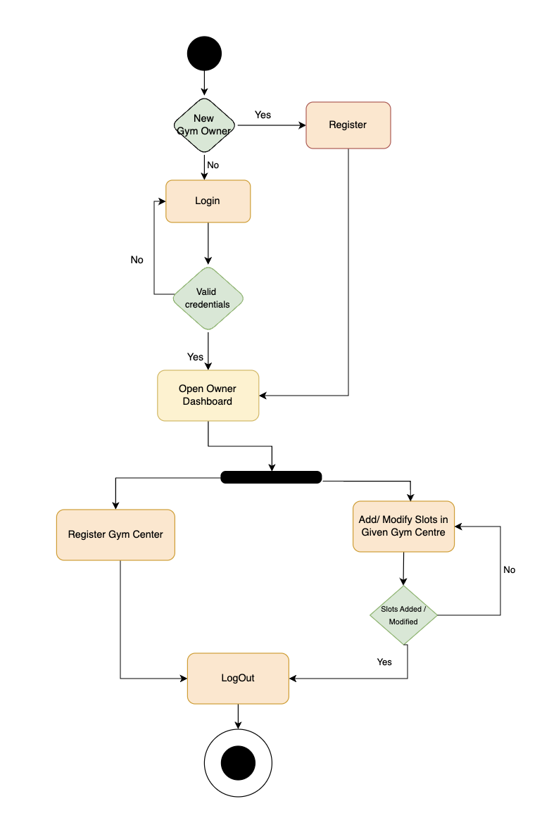
ACTIVITY DIAGRAM
For Gym Owner

Slide 17
WORK
PROGRESS
Design Phase
We began by designing the architecture and UML diagrams
Implementation Phase
The implementation began with learning basic JAVA concepts, and setting up a POS project.
Testing Phase
Involved testing all the methods that the team had implemented
Incorporating DropWizard
Migrating from a POS project to DropWizard

Slide 18
CHALLENGES
Coordination and Communication
Resolving merge conflicts
Debugging the code
Resolving Connectivity issues
Individual Platform issues
LEARNINGS
Team Collaboration
Effective Communication
Tech Stack: Git, Java, MySQL, DropWizard,
Postman
Resolving merge conflicts
Problem-Solving and Debugging

Slide 19
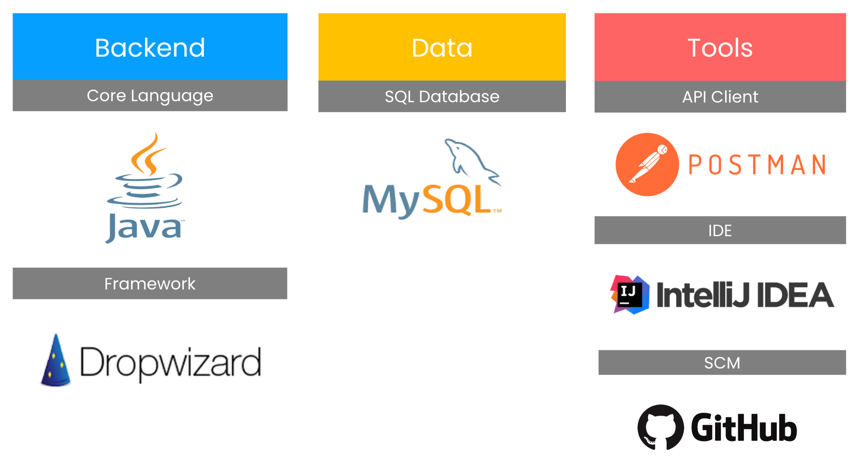


Slide 20
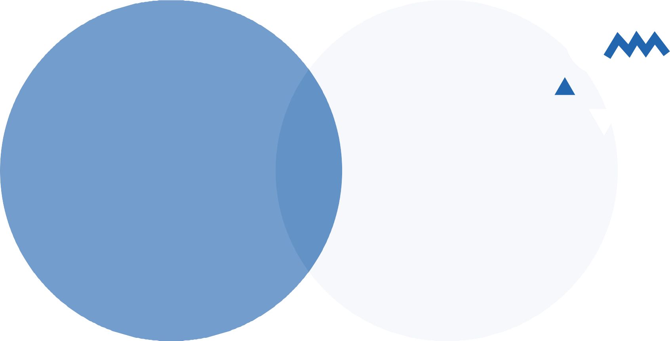
THANK YOU

